Slide 1
Membership UPDATES
Brian King, Membership Director
21 July 2023

Slide 2
Learning & Development UPDATES
21 July 2023
Notes:
Welcome! My name is Kimberly Kouame and I work on the Learning and Development Team. I’m the Learning Resources Manager and my team oversees the Learning Center, creating content for role-based training, and leader’s guides for learning events like PETS.

Slide 3
AGENDA
Transition from Training to Learning
Learning Center Data
Stay Connected
Notes:
Today I’m going to cover three topics.

Slide 4
Transition from training to learning
Notes:
How many of you have heard about our organizational culture shift from training to learning? Maybe you’ve seen the new titles of a select group of roles, etc. Great, I’d like to provide more background and information to you so it can help inform the way you deliver content.

Slide 5
TRAINING vs.
LEARNING
Training is the giving of information and knowledge. We can train others in doing specific tasks or train them in skills through demonstration, explanation, or other methods.
Training is done to the participant.
Notes:
To start, let’s look at some definitions.

Slide 6
TRAINING
vs.
LEARNING
Learning is absorbing information in order to increase skills and abilities. Examples of ways people learn include reading about a topic, discussing ideas, or practicing a skill.
Learning is what a participant does.

Slide 7
Moving from Training to Learning
Content-Centered Training
Participant-Centered Learning
Notes:
Rotary’s approach to knowledge and capacity building is shifting from a training model to a learning model. This is our Action Plan at work as a focus on learning puts participants at the center of what we do. In practice, this means that members will have more active involvement in their learning and more control over it. It also means that people who lead Rotary learning experiences will serve more as facilitators who guide members to share their ideas rather than lecturers who tell members information. We are shifting from requiring training to self-driven learning experiences that bring value to a member’s Rotary experience.
These changes come from our work with the RI Learning Committee who guides us on the direction of Rotary’s training program as the committee looks to make training more effective.
With the work the Learning Committee has done, the RI Board of Directors has approved some changes that will take effect July 1, 2023. We hope you will help us by embracing and supporting these changes in your Multi District PETS.

Slide 8
Changing culture…and names
Club Trainer
District Trainer
District Training Committee
International Assembly Training Leader
Regional Leaders Training Institute
Club Learning Facilitator
District Learning Facilitator
District Learning Committee
International Assembly Learning Facilitator
Regional Leaders Learning Event
Notes:
As a first step, the Board approved some title changes.
Club Trainer was already a position in the code of policies, but clubs will now be able to appoint club learning facilitators in My Rotary. That’s new and means that our team will start communicating with them once we get members assigned to this role.
Approved by the board in January 2023 and took effect 1 July 2023.

Slide 9
Build Curriculum from Online courses
Leader’s guides being revised to build off courses
Online content is for self-paced learning
In-person learning is best for sharing ideas in small groups, action planning, regionalized content, and finding solutions to our challenges.
Notes:
Here’s how we are supporting that. We are building leader’s guides with the assumption that members took the online courses.
Online courses are best for self-paced learning on basic information while in-person learning is best for idea sharing in small groups and regionalized content.

Slide 10
BLENDED LEARNING
Blended learning combines online and in-person study.
It can include courses in Rotary’s Learning Center, in-person learning events, and virtual meetings.
Notes:
Which is essentially a blended learning approach that combines online and in-person study. It can include courses, in-person learning events, and virtual meetings. It can also include planning meetings, job shadowing, and action planning. We believe the best way to prepare for a leadership role in Rotary, is with a blended approach, so we’ve developed infographics to demonstrate this.

Slide 11
Notes:
As you can see here, it’s not just about attending PETS or only taking courses online, there are a lot of things people can be doing to prepare, multiple ways to learn.
HOW MANY HAVE HEARD PETS IS A FIREHOSE OF INFORMATION?
These steps don’t need to be done in order, as you can see the boxes overlap to show that they all work together. These can be found in the Get Ready course for club president, club secretary, club treasurer, district governor, assistant governor, and district Rotary Foundation committee chair and can be downloaded from the Learning Center to share.
The Board of Directors is requiring that club presidents, secretaries, and treasurers complete their role-specific learning plans in the Learning Center before taking office beginning this coming July 1 2024. What does this mean? It means we at least want every club president to log into the learning center, check out the resources available to them, and complete the ones that they feel they need.
Currently most club presidents don’t even know these courses are available. We want to make sure they know where they are and they can demonstrate this by enrolling in the Club President Basics and Club President Intermediate learning plans. We aren’t policing that they finish every course, but we would like to see more club presidents becoming aware of where their resources are.

Slide 12
Notes:
We've started to change our language on the Learning Center from training to learning as part of our culture shift. This is a work in progress.
Event titles that require changes through the Council on Legislation (COL), such as the Presidents-elect Training Seminar, have not been updated yet. Rotary’s Learning Committee will continue to consider what is needed to fully move us from training to learning and will make recommendations to the RI Board. This will include additional code edits and board decisions to change other roles that don’t need COL approval, such as the GETS Team Lead and the IA Seminar Trainer. We’ll be working on this for the next few years with the Learning Committee, the Board, and the COL.
You are encouraged to consider how this shift from training to learning impacts your activities and to start changing where needed.

Slide 13
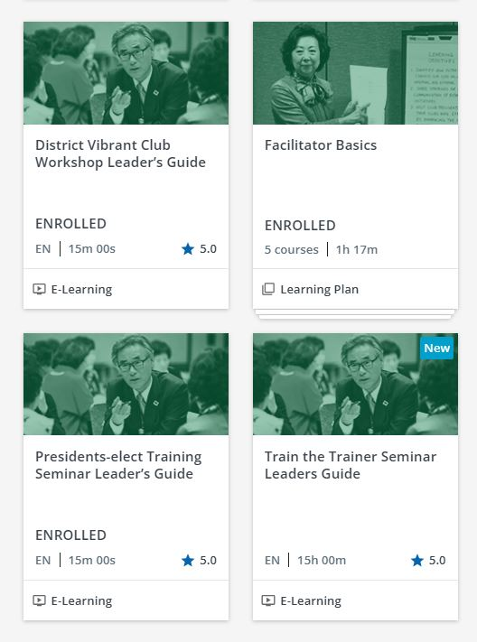
Notes:
The last catalog I wanted to point our was our Trainer catalog. This has basic information on how to facilitate in-person or online sessions. We recommend that anyone conducting training at the club, district, or zone level should complete the Facilitator Basics learning plan prior to the event. We also recommend hosting in-person practice sessions for your facilitators to practice their session and receive feedback from their peers, like what IA Learning Facilitators do to prepare for the International Assembly the week before governors-elect arrive.
Several of our Leader’s Guides are in here including the PETS LG and District Training Assembly LG which is newly revised this year.

Slide 14
Club President Basics
Courses 2022-23 | Courses 2023-24
Getting Started with the Learning Center | Getting Started with the Learning Center
Get Ready: Club President | Get Ready: Club President
Managing Club Business | Managing Club Business
Working with Your Club Leadership Team | Working with Your Club Leadership Team
Minimizing Risk | Minimizing Risk
Rotary’s Action Plan and You | Rotary’s Action Plan and You
Best Practices for Engaging Members | Best Practices for Engaging Members
Rotary Club Central Resources | Rotary Club Central Resources
Online Membership Leads | Online Membership Leads
Rotary Foundation Basics | Rotary Foundation Basics
Protecting Youth Program Participants
Notes:
These slides show the current learning plan changes for July 2023.
We did an audit of all role-based learning plans and adjusted them to build on each other and ensure each role had the right courses.

Slide 15
learning plans - Club
Courses current | Courses new
Is Your Club Healthy? | Is Your Club Healthy?
Be a Vibrant Club | Be a Vibrant Club
Creating an Inclusive Club Culture | Creating an Inclusive Club Culture
Strategies for Attracting New Members | Promoting your Club as People of Action
Promoting your Club as People of Action | Committing to Diversity, Equity, and Inclusion
Our Logo: Representing Rotary | Preventing and Addressing Harassment
Committing to Diversity, Equity, and Inclusion | Protecting Personal Data
Preventing and Addressing Harassment | Leading Change
Protecting Personal Data | Protecting Youth Program Participants
Leading Change
Notes:
Here we added back the Protecting Youth Program Participants and removed two courses that are geared more for club membership chair and club PI chair.

Slide 16
Data
Notes:
SPEAK SLOWLY KIM - Let’s look at the numbers.

Slide 17
Total Learners
190,900
The unique number of members and non-members in the Learning Center since launch in August 2018.
Notes:
30 June 2023–approximately 13% of members who have visited the LC. (Rotarians and Rotaractors)

Slide 18
Course Completions by Zone
Notes:
As of 1 July 2022

Slide 19
Course Completions by Zone
Notes:
As of 1 July 2022

Slide 20
Percentage of Clubs using the learning center
2018-19
2019-20
2020-21*
2021-22*
2022-23*
16%
43%
47%
51%
57%
49%
84%
53%
5,684 clubs
15,656 clubs
18,325 clubs
22,766 clubs
23,426 clubs
*+ Rotaract
Notes:
The 2022-23 numbers are based on 31 May club figures (48,372 clubs) and include both Rotary and Rotaract clubs. The goal is to have all clubs participating in the Learning Center.

Slide 21
Course evaluation findings
Most hear about courses from district leaders
97% said that the course is relevant to their role
95% said that the course met their expectations
92% said they learned something new from the course
78% are confident and 19% are somewhat confident that they will be able to apply what they learned from the course
Notes:
SPEAK SLOWLY KIM – You may have noticed that there is a course evaluation at the end of every course. Here’s what that evaluation data is telling us.
Review the data on the slide
Remind people that they aren’t required to complete the course evaluation each time, but in order to complete the course, they need to at least click on the course evaluation so it appears as complete.

Slide 22
Customize Content
Create customized learning plans
Request a learning topics for your district or zone by topic or language
Notes:
You can email our team with a list of individual courses you would like to see in a learning plan. The benefit of this is if you are asking members to take a group of individual courses, we could give you one deep link and you can track progress of the learning plan on your reports.
You can also request us to set up a learning topic for your zone or district by topic or language. For example, we have a topic called District 5890 Expanding Our Reach only visible to members in D5890. We also have several catalogs for other languages. For example, we enrolled Chinese-speaking districts in a learning topic for Rotary Resources in Chinese. This reminds me if you speak a language not represented here, but members in your district translate Rotary materials into your local language, and you would like to post materials in a central location, you can use the Learning Center.

Slide 23
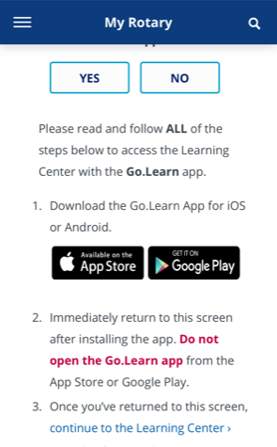
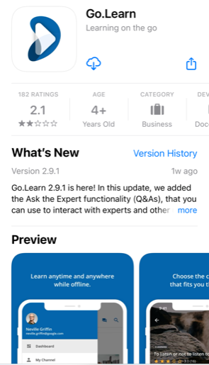
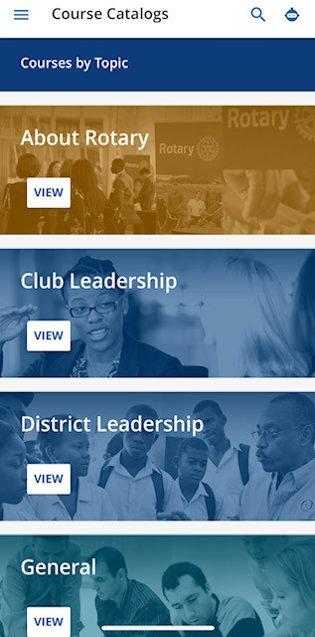
mobile
Notes:
MEGAN – Finally, you can access the Learning Center via Mobile. If you prefer to browse the Learning Center with a mobile device, there is an app called Go.Learn. To access this app, visit my.rotary.org on your mobile device and sign in. Then click on Learning & Reference just like they would on a computer. Please be sure to pay close attention to the instructions otherwise the app will not open correctly. Once the app is downloaded, users will need to continue this same sign in process for when they want to use the mobile app.
Please note there are some limitations to the mobile app, such as links to specific courses or learning plans may not open due to the sign in process. But this should be working shortly.

Slide 24
Stay connected
Notes:
SPEAK SLOWLY MEGAN – Now that you’ve learned about all the content available and how to access the content, let’s look at how to stay connected to what’s new.

Slide 25
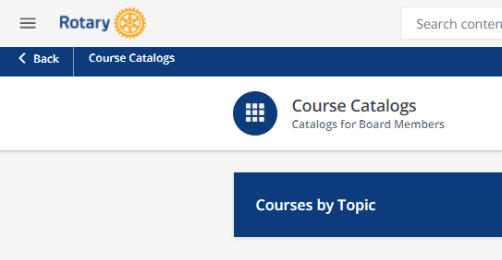
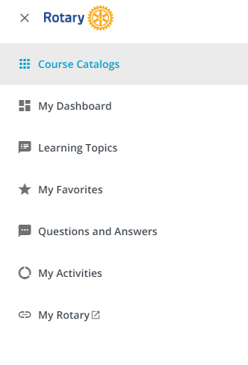
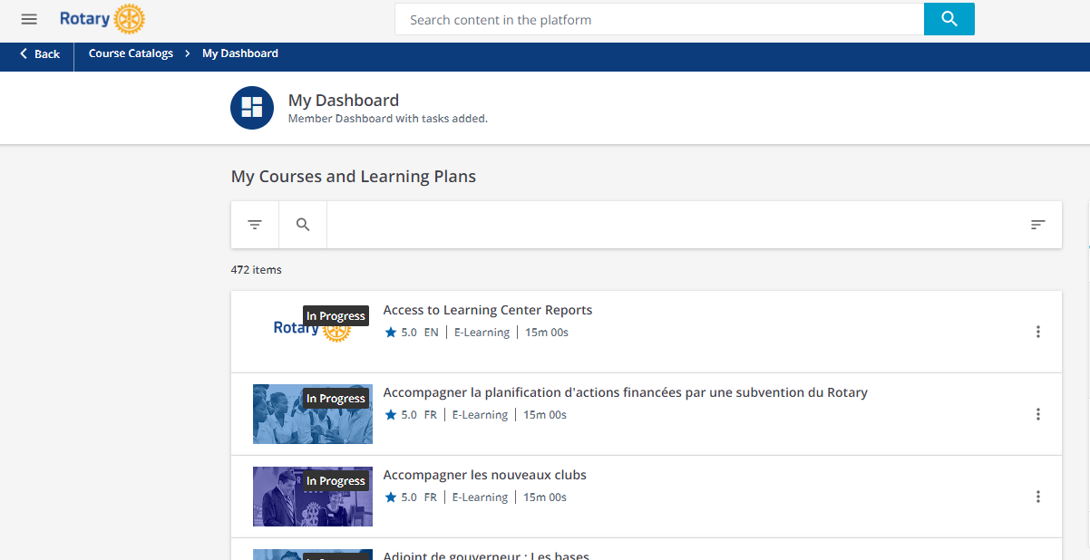
Get Access to Reports
1
2
3
Notes:
First, if you don’t currently receive reports, and you are a DG, DGE, DGN, DT, DMC, or DRFC, you can complete the Access to LC reports and complete the course. Here are the steps:
Click the three lines at the top to access the menu
Choose My Dashboard
Click the Access to Learning Center Reports course. If it doesn’t appear on the top you can filter in the top right corner A-Z.
Complete the course and you should have access to reports the following Monday.
These members can share reports with other district committees, Ags or clubs if they are interested. The district leaders can decide if someone else needs to manage the reports and they can share them.

Slide 26
Emails from the Learning Center
learn@learnmail.rotary.org
Add this email to your approved sender list
Notes:
Emails with reports or reminders to take courses come from learn@learnmail.rotary.org. If you want to receive these messages in your inbox, you need to whitelist the email, or add it to your list of approved senders. If you don’t know how to do this, simply google “how to add an email as an approved sender in yahoo mail or whatever email server you have”

Slide 27
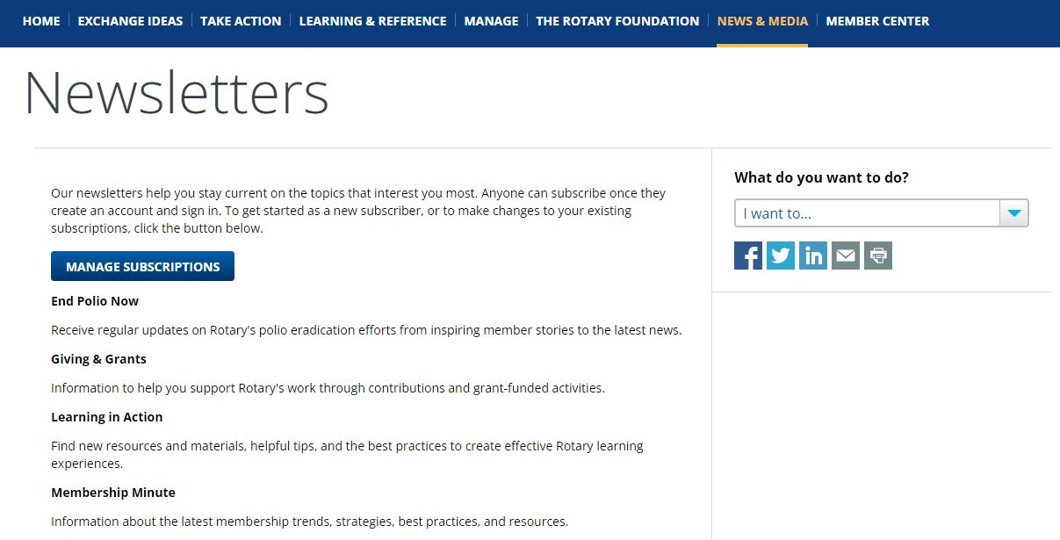
STAY CONNECTED: Learning IN Action
Notes:
If you would like to receive communications from us about new courses or other information related to the Learning Center and more, you can go to My.Rotary > News & Media > Newsletters and manage your subscriptions. Be sure to select “Learning in Action” for updates.
Note that we are in the process of updating this page to reflect the new newsletter title to Learning in Action.

Slide 28
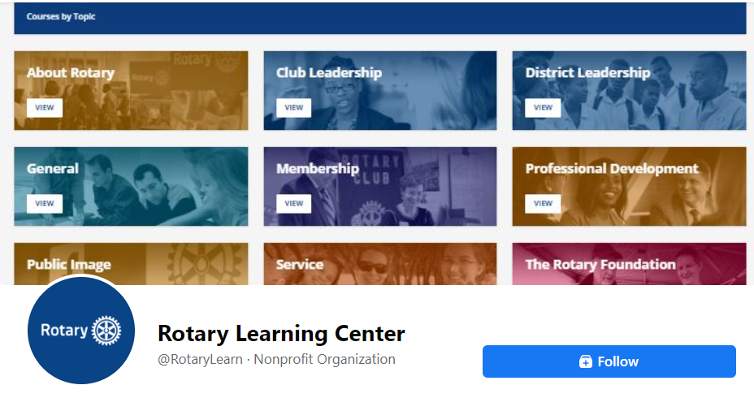
STAY CONNECTED: facebook
Notes:
MEGAN - The Learning Center also has a Facebook page! Visit our page for new and revised course promotions, data, and tips. In addition, please share the page and any tips posted to your Facebook feed. This helps us spread the word to Rotarians about this great learning tool.

Slide 29
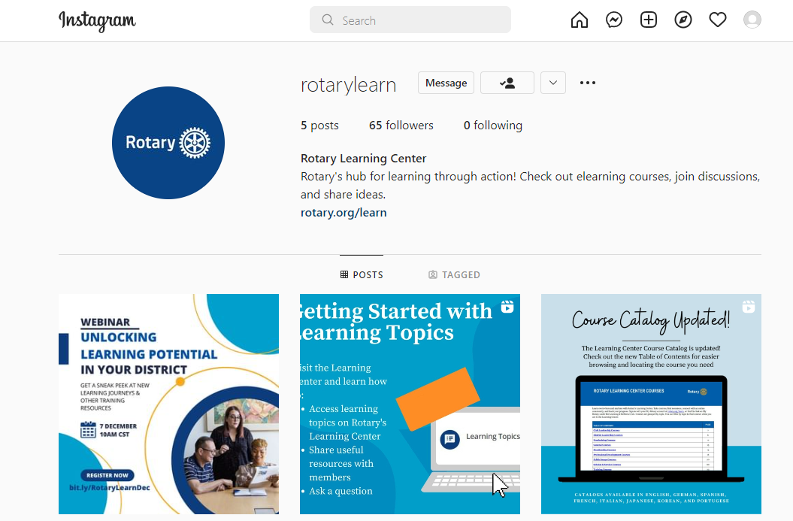
Stay connected: instagram
Notes:
And we recently just started a LinkedIn account.

Slide 30
QUESTIONS?
EMAIL LEARN@ROTARY.ORG
Notes:
If you should have any questions about the Learning Center or run into technical issues, you can contact learn@rotary.org for assistance.
Let’s take a few minutes to see if the audience has any questions. X is going to help share some questions to respond to.

